Slide 1
Recommendation Engnie Netlix

Slide 2

Introduction
Exploring the impact of Netﬂix's Recommendation Engine on user satisfaction and retention.
Understanding the key factors driving the success of the algorithm and its implications for the streaming industry.

Slide 3
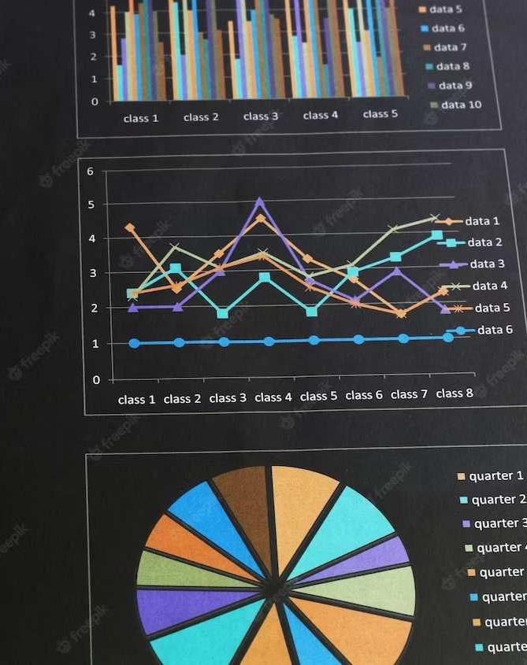
Understanding User Behavior
Analyzing the viewing patterns and preferences of Netﬂix users. Examining the data points that contribute to the accuracy of the recommendation engine, including genre preferences, viewing history, and user ratings.

Slide 4

Machine Learning
Algorithms
Cosine Similarity
k Near Neighbours 3.TF-IDF
Non Negation Matrix Factorization
Decision Tree
Random Forest
Naive Bayes

Slide 5

Personalization at Scale
Examining how Netflix Achives
personalization at scale through its recommendation engine.
Understanding the challanges and solution in delivering tailored content recommendations to millions of users world wide .

Slide 6

Enhancing User Engagement
Exploring how the recommendation engine contributes to
and satisfaction.
Discussing the impact of personalized recommendations on user retention and overall viewing experience.

Slide 7
Conclusion
Reﬂecting on the transformative impact of Netﬂix's recommendation engine on the streaming industry.
Emphasizing the significance of user-centric algorithms in driving customer loyalty and business success.

Slide 8
Thanks!
By Group-4 Tharakanadh Sanjay Abdul Aziz
Sarath Chandra Thanishq
Prakalpa Awasthy

